Slide 1
PRIMARY COLORS The Art of Teaching & Learning with Primary Sources in the Library LOEX 2014
Adam Beauchamp
Tulane University
May 9, 2014

Slide 2
Professor:
“I am hoping to get them to think about using archival materials.”
Notes:
Professors in history and the social sciences often want students to incorporate primary sources into their research assignment.

Slide 3
Students:
“I need primary sources for my paper on gender roles in Victorian London. What databases do you have?”
“Where can I find data for my research on Spaniards’ changing attitudes toward the afternoon siesta.”
“Still a bit unclear on finding primary sources vs secondary. I know the difference between the two but not necessarily the best place to look for each.
Notes:
Students can name types of primary sources at a superficial level if you ask them (primary sources are newspapers, diaries, etc.; secondary are books, journal articles), but in the heat of the research assignment, seek primary sources in the same way as they do secondary sources. Online search tool -> Keywords -> results.
So they ask me where to look, where to find…assuming they can take care of the rest.
They don’t always realize primary sources are used/read differently than secondary sources.

Slide 4
Students:
“I need primary sources for my paper on gender roles in Victorian London. What databases do you have?”
“Where can I find data for my research on Spaniards’ changing attitudes toward the afternoon siesta.”
“Still a bit unclear on finding primary sources vs secondary. I know the difference between the two but not necessarily the best place to look for each.

Slide 5
Professor:
“They are not thinking about how to research this as a history paper…. Even one of the top students in the class is just kind of randomly looking for things about race in Cuba.”
Notes:
How do professors’ approaches differ?
They want students to use primary source materials in their research in the same way they do, using disciplinary methods and heuristics. They might assign a research paper and require inclusion of primary and secondary sources, but not realize that students don’t necessarily know they are used differently from one another.

Slide 6
Pedagogy

Slide 7
Experts v. Novices
Scholars
Students
Author intention
Audience reaction
Context
Subtext
Basic reading comprehension
Recall
Fact finding
Sam Wineburg, Historical Thinking and Other Unnatural Acts (2001).
Notes:
Sam Wineburg, Stanford University, Graduate School of Education
When it comes to primary sources, primarily texts, what can students do? Often students read texts for basic comprehension and retention, like they would to prepare for a test, perform on SAT exam questions, or write a high-school level paper. This is not how disciplinary experts read texts, looking for author intention, audience reaction, context, conscious and unconscious subtexts (Wineburg 2001: 68-9).
Students often try to find and use primary source just as they would secondary sources, without recognizing primary sources require a different approach and use method.
As an aside, professors and I have also seen this phenomena with students’ use of secondary sources. They excel at reading a scholarly article for basic understanding (what was the study, what were the findings), but don’t always grasp the communicative properties of publishing, where scholars respond (and often disagree). Students might also fixate on the specifics of a study (basic reading comprehension) but miss the broader conceptual and theoretical value (scholarly context).

Slide 8
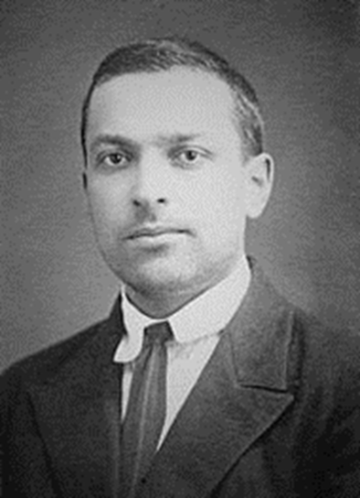
Zone of Proximal Development
Distance between what can be done independently, and what can be done with guidance
New skills and knowledge happen first on the social level, and second on the individual level
Lev Vygotsky, Mind in Society (1978).
Notes:
Lev Vygotsky (1896-1934)
Zone of Proximal Development (ZPD) is the “distance between the actual developmental level as determined by independent problems solving and the level of potential development as determined through problem solving under adult guidance or in collaboration with more capable peers” (Vygotsky 1978:86).
In other words, what they can do on their own (existing skill/knowledge) and what they can accomplish with help (potential skill/knowledge).
Acquiring new concepts is socially constructed. “An interpersonal process is transformed into an intrapersonal one. Every function in the child’s psychological development appears twice: first, between people (interpsychological), and then inside the child (intrapsychological)….All higher functions originate as actual relations between human individuals” (Vygostsky 1978:57).

Slide 9
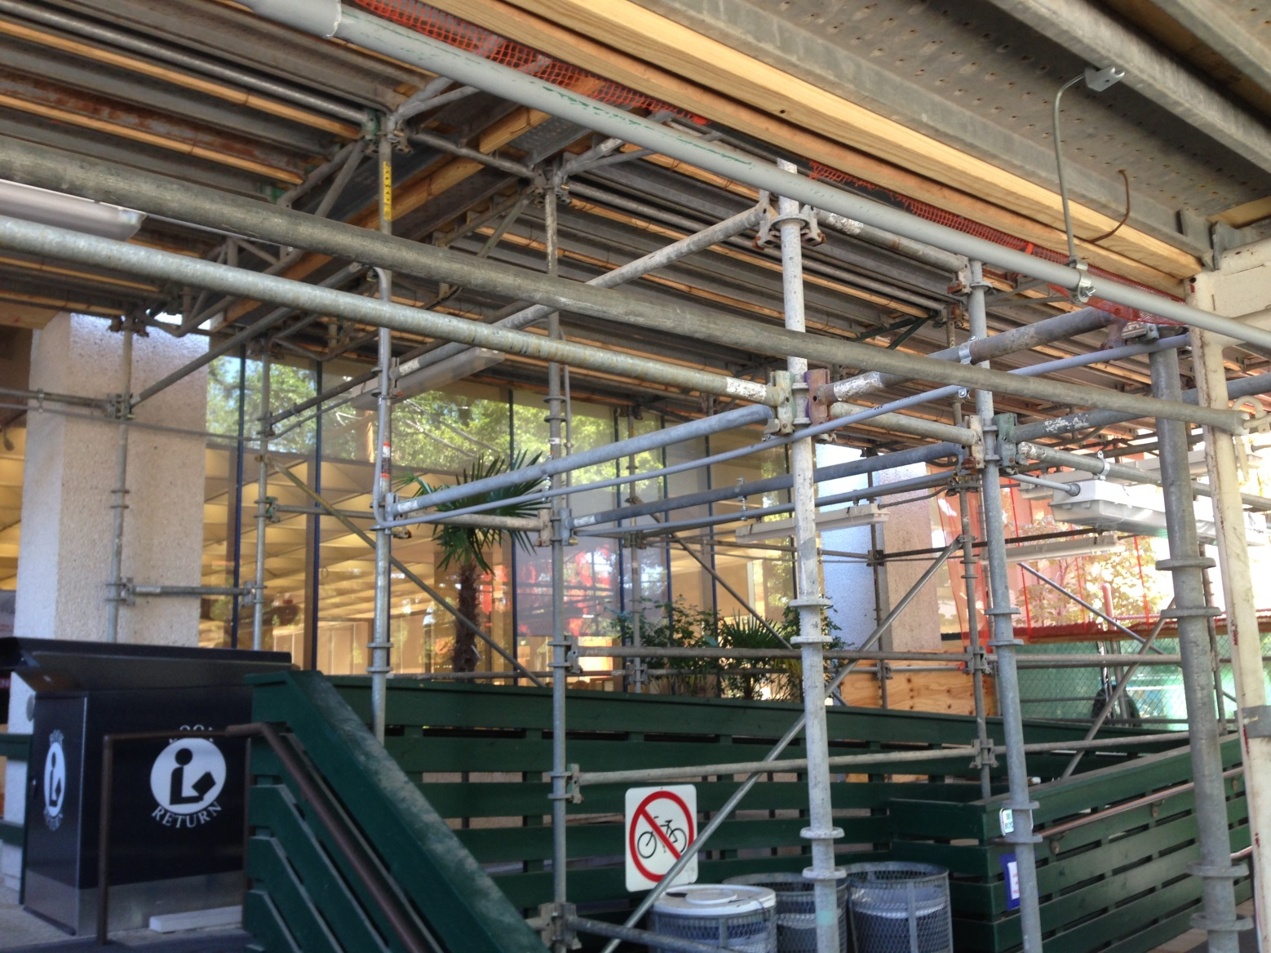
Scaffolding
Notes:
At my library, Howard-Tilton Memorial Library, the entrance is currently surrounded by scaffolding. The construction team refers to it at FOPS (falling object protection system).
This slide is just for fun. ☺

Slide 10
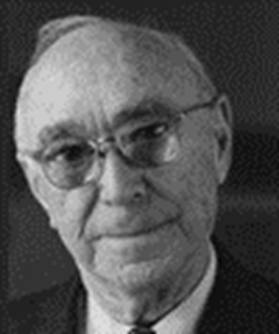
Scaffolding
Relationship between expert and novice in the process of acquiring new skills
Expert creates “reduction in degrees of freedom”
Break down into steps
Focus on one task/concept at a time
Sequence of active learning methods
Jerome Bruner, Actual Minds, Possible Worlds (1986).
Notes:
Jerome Bruner
What can the instructor do to help bridge the ZPD, to bring basic comprehension readers toward expert content analysis reading?
Bruner uses the metaphor of scaffolding to cross Vygotsky’s ZPD. The expert guides the novice through a sequence of exercises, gradually shifting from high levels of expert guidance to greater student independence. Requires deconstructing the experts conceptual knowledge into discrete parts, deploying teaching methods that stay ahead of students’ existing level of development, but not too far so as to allow incremental growth, avoid frustration.
Reducing the degrees of freedom by presenting tasks/concepts in digestible pieces before moving on to the next/larger concept.
Keep in mind that scaffolding is what the teacher does, not what the learner is asked to do. For example, breaking down a research paper assignment into smaller assignments (thesis statement, annotated bibliography, rough draft, final draft) is not true scaffolding since it relies on the students’ individual, existing conceptual development, and essentially assumes the students could write the final product all along. True scaffolding in this instance would involve the teacher recognizing the ZPD for thesis statement formulation, which requires an understanding of existing scholarship, the communicative nature of scholarship, the realm of possible topic-method pairs appropriate to the discipline, and the availability of data that can be deployed in pursuit of such a topic-method pairing. Thesis statement may not be the place to start after all!

Slide 11
In the Classroom

Slide 12
Sociology 3030: Research Design
“I am hoping to get them to think about using archival materials.”
How do sociologists use “archival materials”?
What types of archival materials have sociologists used?
What types of archival materials does the library have?
Which archival materials could be deployed in a one-shot session?
Notes:
Sociologists are talking about “content analysis” when they talk about using archives, primary sources, etc. These could be texts, images, sounds, or any other symbolic representation of a sociological phenomena. Methodologically, content analysis refers to “making replicable and valid inferences from texts (or other meaningful matter) to the context of their use.” (Krippendorff 2010: 234). This is not unlike the use of primary source materials in other liberal arts fields.
A search in Sociological Abstracts reveals a broad range of source material types that sociologists might turn to for content analysis. In addition to texts, these might include photographs, television media, film, personal ads.
What types of materials are in the library, and could be deployed in the one-shot? Lots, but based on professor’s preference, we limited to non-digital resources, and I eliminated microfilm based on usability in a classroom.

Slide 13
The Scaffolded One-Shot
Modeling (precedes library session)
Regular lecture & class readings
Independent homework assignment
Discussion
Students report the types and uses of content in sociology articles they found
Create list of content types on board
Group Exercise
Students work in teams, support one another’s learning
Hands-on practice with the methodology
Notes:
Modeling (notice mini-scaffolding within the modeling component)
Students read textbook chapter about content analysis, and an article representative of the method in use by a sociologist.
Students receive lecture and discuss readings in class with professor.
Homework: Students locate and read a published journal article in which content analysis methodology is used.
At the Library
Class Discussion (Moderated by librarian)
Librarian asks how students found their articles (review of how to search Sociological Abstracts). Particularly interested if students went beyond the given instructions (put “content analysis” in the Abstract field) by adding additional keywords, limiting by date, other facets).
2. Librarian invites students to describe the study they read, identifying what was the content used (primary source materials), and what sociological question did the author address. Also, was the author’s interpretation convincing/successful?
3. Librarian makes a running lists of types of content and types of research questions while students contribute, providing commentary and follow-up questions as appropriate.
Group Work
Students are divided into groups and given “content” selected from the library’s print collections. (Reduction in degrees of freedom = take away the task of identifying need and finding sources in order to focus on what kinds of sources are suitable and how to apply the method)
Librarian & Professor circulate to keep groups on task, ask probing questions, etc.
Groups describe their content, a sociological research question relevant to the content, and their proposed means of applying content analysis methodology.
Exam
1. Professor asks questions on midterm relating to content analysis methodology, giving students the chance to demonstrate individually their understanding of the method and its application.

Slide 14
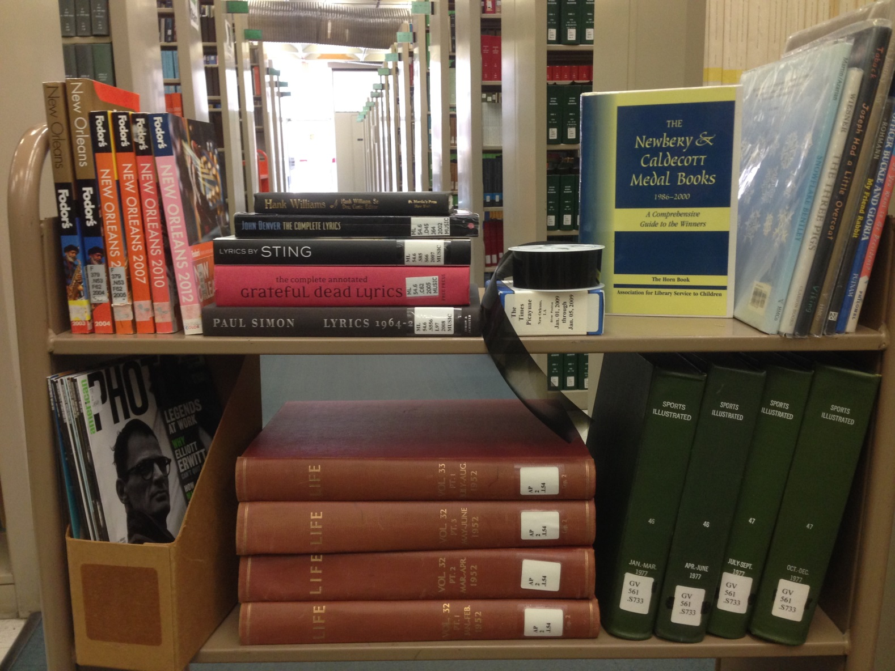
A Building Full of Content
Notes:
Selected content has included:
Bound volumes of Life magazine from 1952;
Bound volumes of Sports Illustrated from the 1970s;
Caldecott prize-winning children’s books;
Published song lyrics by Hank Williams, Paul Simon, John Denver;
U.S. history textbooks from the 1980s and 1990s;
American Photo magazine, recent issues;
Money magazine, recent issues;
Fodor’s Guide to New Orleans, spanning the 1990s, 2000, 2010s;
Spool of microfilm for demo purposes only, usually referencing newspapers.

Slide 15
Feedback
“I think it went really well ... I really think students ‘get it’ when they do something hands-on, and the wide range of materials you picked was fun and creative.”
Post-session, 3/6/2013
“Based on their exam performance and in-class discussion following the content analysis exercise, this group of students definitely understood what it took for them to use these data for research. It has inspired me to do more hands-on exercises in class on other topics in the future.”
End of semester, 5/8/2013

Slide 16
Expanding the Model
History professor: “A video of us should be on the Howard Tilton website. We had relatively inexperienced Tulane undergraduates poring over primary documents in three languages and muddling slowly through context and historical debates.”
Political science student: “I learned about many more data sites available through the library. There is a lot of Census data…it was cool to look at our hometowns.”
Notes:
Since the initial successes in the sociology methods course, I’ve applied the same pedagogical approach and lesson plan structure to history and political science classes.
In history, I teamed up with an archivist in our special collections to have students work hands-on with archival documents, selected for them and related to the broad topic of the course (slave rebellions).
In a political science methods course, we worked with online Census data (Social Explorer) and election returns to ask questions about voter turnout and demographics. And every students seems to enjoy playing with Census data visualizations on their hometowns and census tracts.

Slide 17
Select Bibliography
Bruner, Jerome S. Actual Minds, Possible Worlds. Cambridge, MA: Harvard University Press, 1983.
Krippendorf, Klaus. 2010. “Content Analysis.” Pp. 234-36 in Encyclopedia of Research Design, edited by Neil J. Salkind. Thousand Oaks, CA: SAGE Publications.
Vygotsky, Lev. 1978. Mind in Society. Cambridge, MA: Harvard University Press.
Wineburg, Sam. 2001. Historical Thinking and Other Unnatural Acts. Philadelphia, PA: Temple University Press.
Wood, David, Jerome S. Bruner, and Gail Ross. 1976. “The Role of Tutoring in Problem Solving.” Journal of Child Psychology and Psychiatry 17(1):89-100.

Slide 18
Adam Beauchamp
Research & Instruction Librarian
Tulane University
abeaucha@tulane.edu
adambeauchamp.wordpress.com
@delayedcajun

